Slide 1

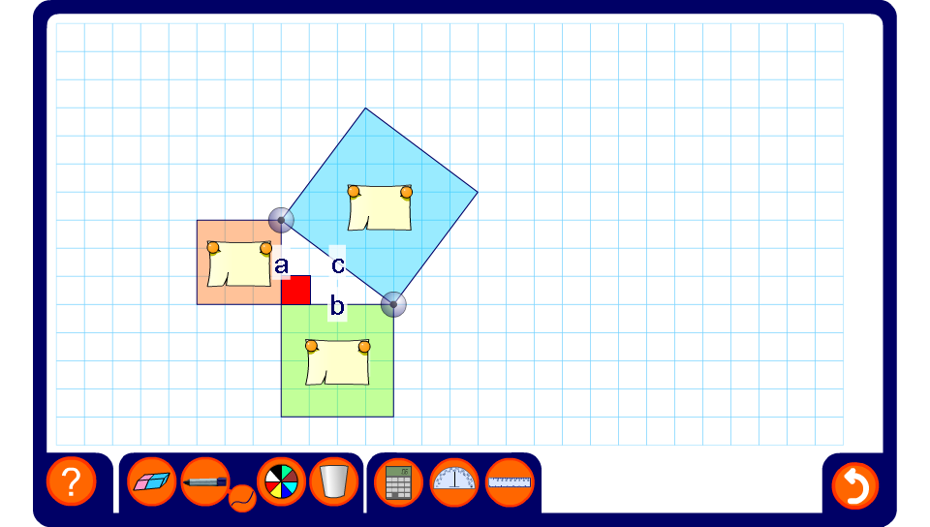


Showing Pythagoras’ Theorem
Notes:
Drag the vertices of the triangle to change the lengths of the sides and rotate the right-angled triangle.
Ask a volunteer to come to the board and use the pen tool to demonstrate how to find the area of each square. For tilted squares this can be done by using the grid to divide the squares into triangles and squares. Alternatively, a larger square can be drawn around the tilted square and the areas of the four surrounding triangles subtracted.
Reveal the areas of the squares and verify that the area of the largest square is always equal to the sum of the areas of the squares on the shorter sides.

